Slide 1
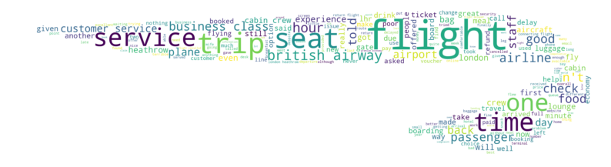
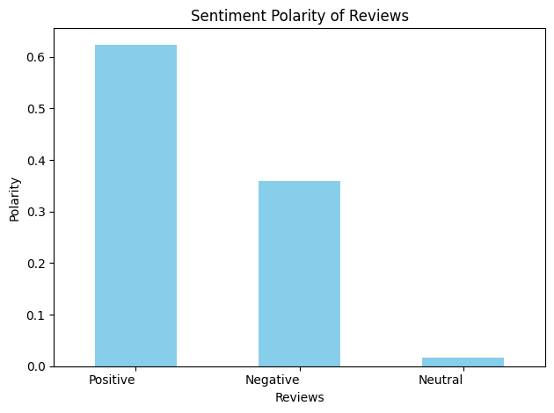
Summary of Analysis
Scrape and analyse customer review data to uncover findings for British Airways
The word cloud highlights key air travel terms such as "flight," "seat," "service," "time," ,"staff," "food," and "business class."
Out of 1000 reviews, sentiment analysis reveals over 60% positive reviews and nearly 40% negative reviews.
In conclusion, focusing on improving food quality and seating conditions could significantly enhance overall customer satisfaction and improve the travel experience.

